Slide 1
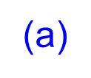






Problem 5.1 P202

Slide 2
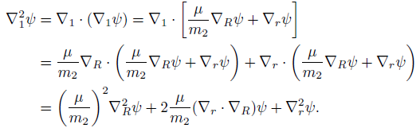







(b)

Slide 3




(c)

Slide 4



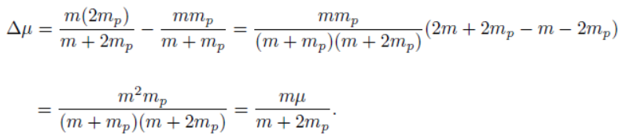
Problem 5.2 P203
(a)
(b)

Slide 5






(c)

Slide 6


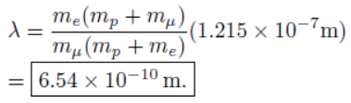
(d)
So R is changed by factor:

Slide 7


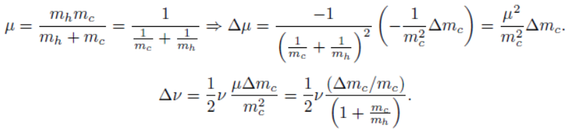
Problem 5.3 P203

Slide 8


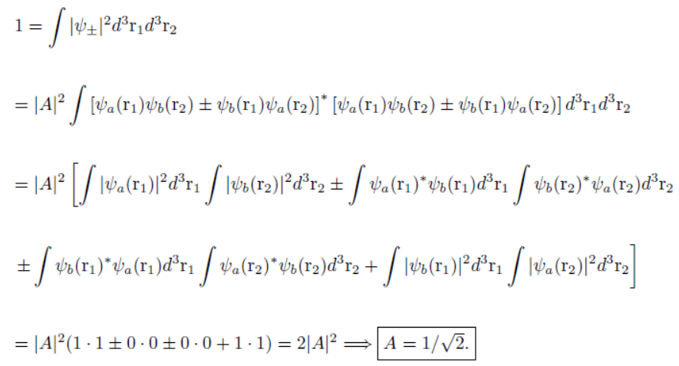
Problem 5.4
(a)

Slide 9
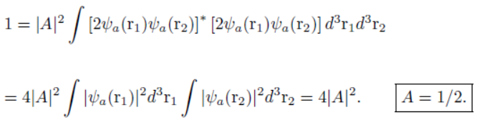


(b)
Problem 5.5
(a)
(b)
Distinguishable particles

Slide 10
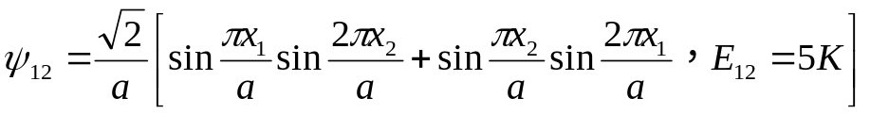
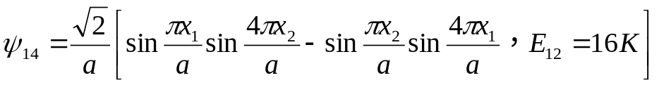
Identical bosons
Identical fermions

Slide 11
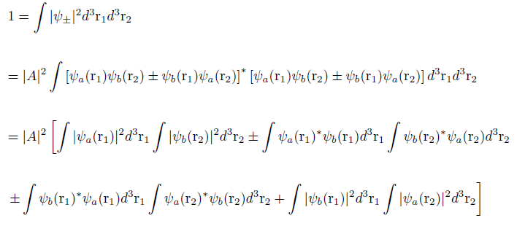



Problem 5.4 P206
(a)
(b)

Slide 12





Problem 5.5 P206
(a)
(b)
Distinguishable

Slide 13
Identical Bosons
Identical Fermions

Slide 14



Problem 5.6 P210
(a)
Distinguishable particles
(b)
Identical bosons

Slide 15


(c)
Identical fermions
Problem 5.7 P210
(a).

Slide 16
(b).
(c).
Problem 5.8 P211

Slide 17




Problem 5.9 P214
(a).
The energy of each electron is:
The total energy is:
The ground state energy is:
The emitted electron energy is:
(b).

Slide 18





Problem 5.11 P214
(a).
(b).
Problem 5.15 P223

Slide 19




Problem 5.16 P223
(a).
(b).
(c).
(d).

Slide 20









Problem 5.17 P223
Problem 5.18 P229
(a).

Slide 21







(b).
Eq5.62
Problem 5.19 P229

Slide 22
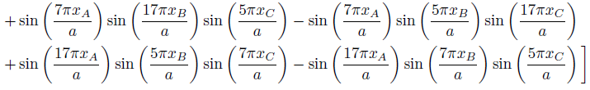

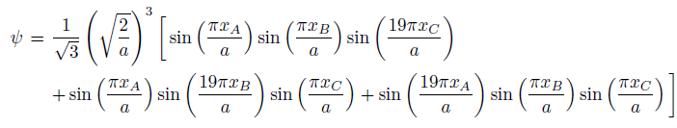
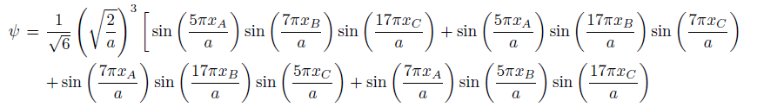
Problem 5.22 P233
(a).
(b).

Slide 23
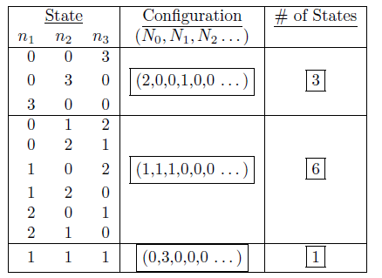
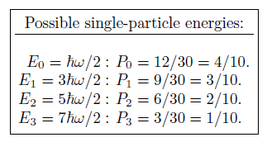
Problem 5.23 P233
(a).
Most probable configuration:
Most probable single-particle energy:

Slide 24

(b).
(c).
One state for each:
Most probable single-particle energy is E₁:
Problem 5.25 P235

Slide 25
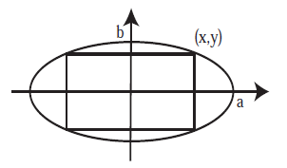












Problem 5.26 P239
or

Slide 26









Problem 5.32 P245
(a).
(b).
(c).

Slide 27
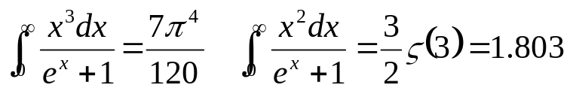

Slide 28

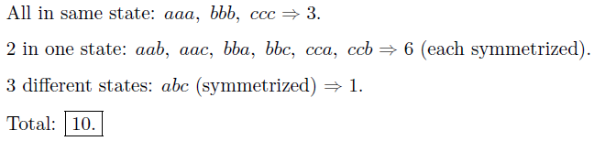

Problem 5.33 P246
(a).
(b).
(c).

Slide 29



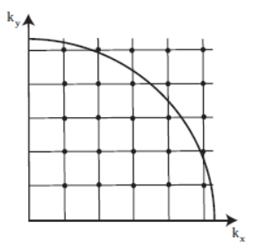


Problem 5.34 P246

Slide 30
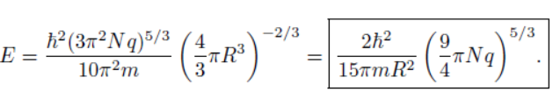






Problem 5.35 P246
(a).
(b).

Slide 31
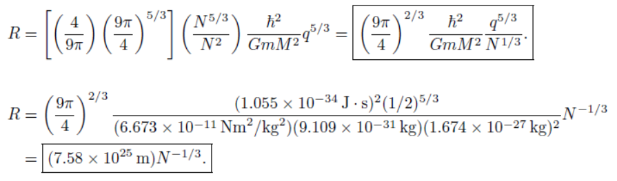
(c).

Slide 32



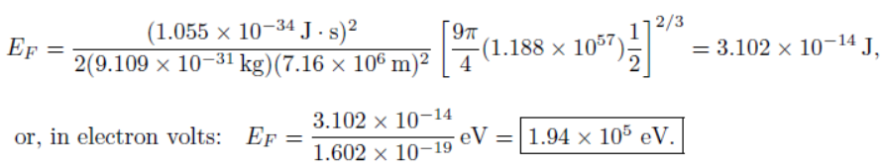
(d).
(e).

Slide 33




Problem 5.36 P247
(a).
(b).

Slide 34




(c).

Slide 35
Homework
Problem 5.10
Problem 5.18
Problem 5.20
Problem 5.38

